Slide 1
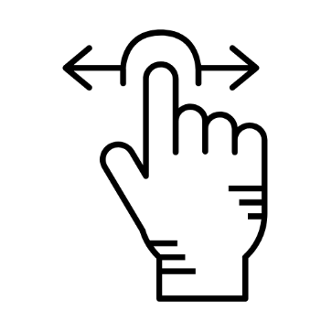
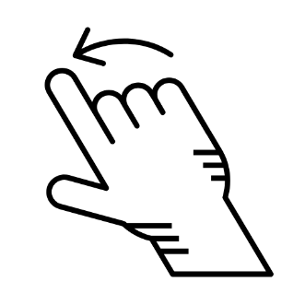



Hand Gesture Activities for Digital Interaction
By
Nisar
Charanjit

Slide 2
INTRODUCTION
Project Goal : Build a software system to perform Digital interaction based on Hand Gestures. Digital Interaction like:
Navigating through Documents
Mouse Functionalities
Media Control
Objective :
To enhance user experience and interaction by harnessing hand detection and gesture recognition for seamless digital engagement

Slide 3

FEASIBILITY STUDY
Technical Feasibility:
Utilizes webcam input and Python libraries for real-time gesture detection.
This system is cost-effective and can run on any standard machine.
Operational Feasibility:
Crafted to seamlessly integrate with existing digital systems, providing flexibility in deployment with minimal added costs.
Economic Feasibility:
Cost-effective, leveraging open-source libraries and minimal hardware requirements like camera.

Slide 4




REQUIREMENT ANALYSIS
Hardware Requirements:
Webcam
computer.
Software Requirements: Python
OpenCV,
MediaPipe,
pyautogui, and
Pynput libraries.
Non Functional Requirements:
The system should have high accuracy in recognizing gestures to avoid false positives or negatives..
Modularity in code structure should support easy updates and extensions.
Functional Requirements:
Detect hands in real-time
from webcam
Perform actions based on gestures

Slide 5
DESIGN & MODELLING
The architecture is divided into key layers:
Input layer (webcam for video capture),
processing layer (gesture detection and control modules)
Output layer that triggers OS controls like mouse actions, Document navigation
Data flow between components ensures the user’s gestures are quickly recognized and converted into commands for digital interaction.
The design diagrams, including Class Diagram, Activity Diagram , Use Case Diagram outline the flow from gesture input to system response, ensuring modularity and ease of use

Slide 6
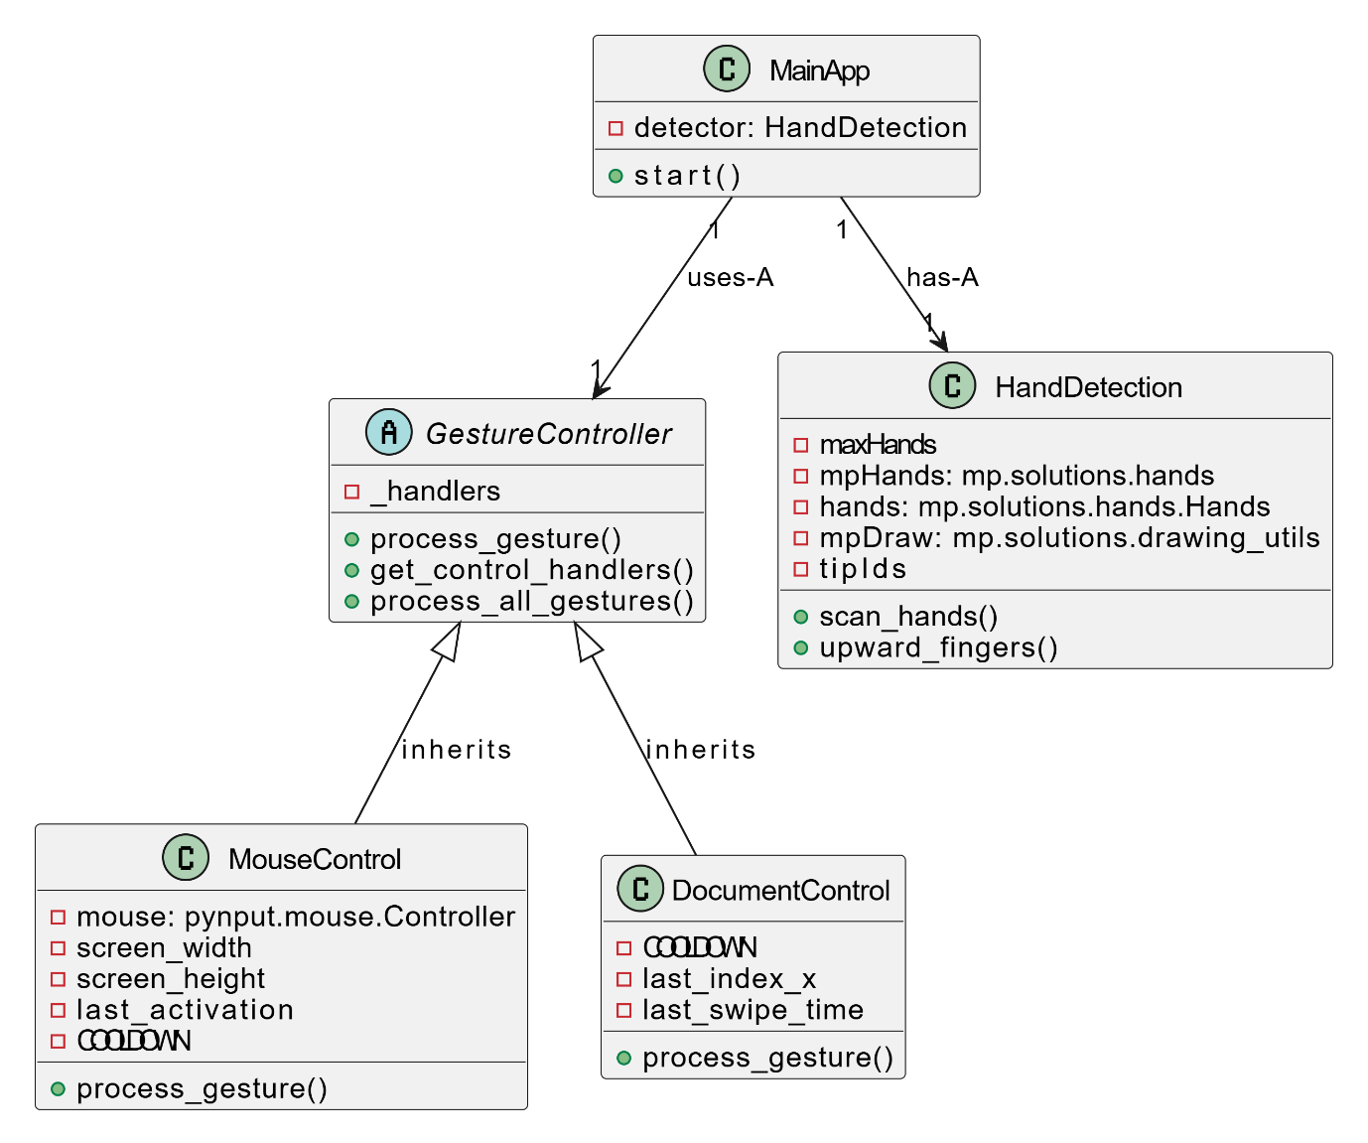
CLASS DIAGRAM

Slide 7
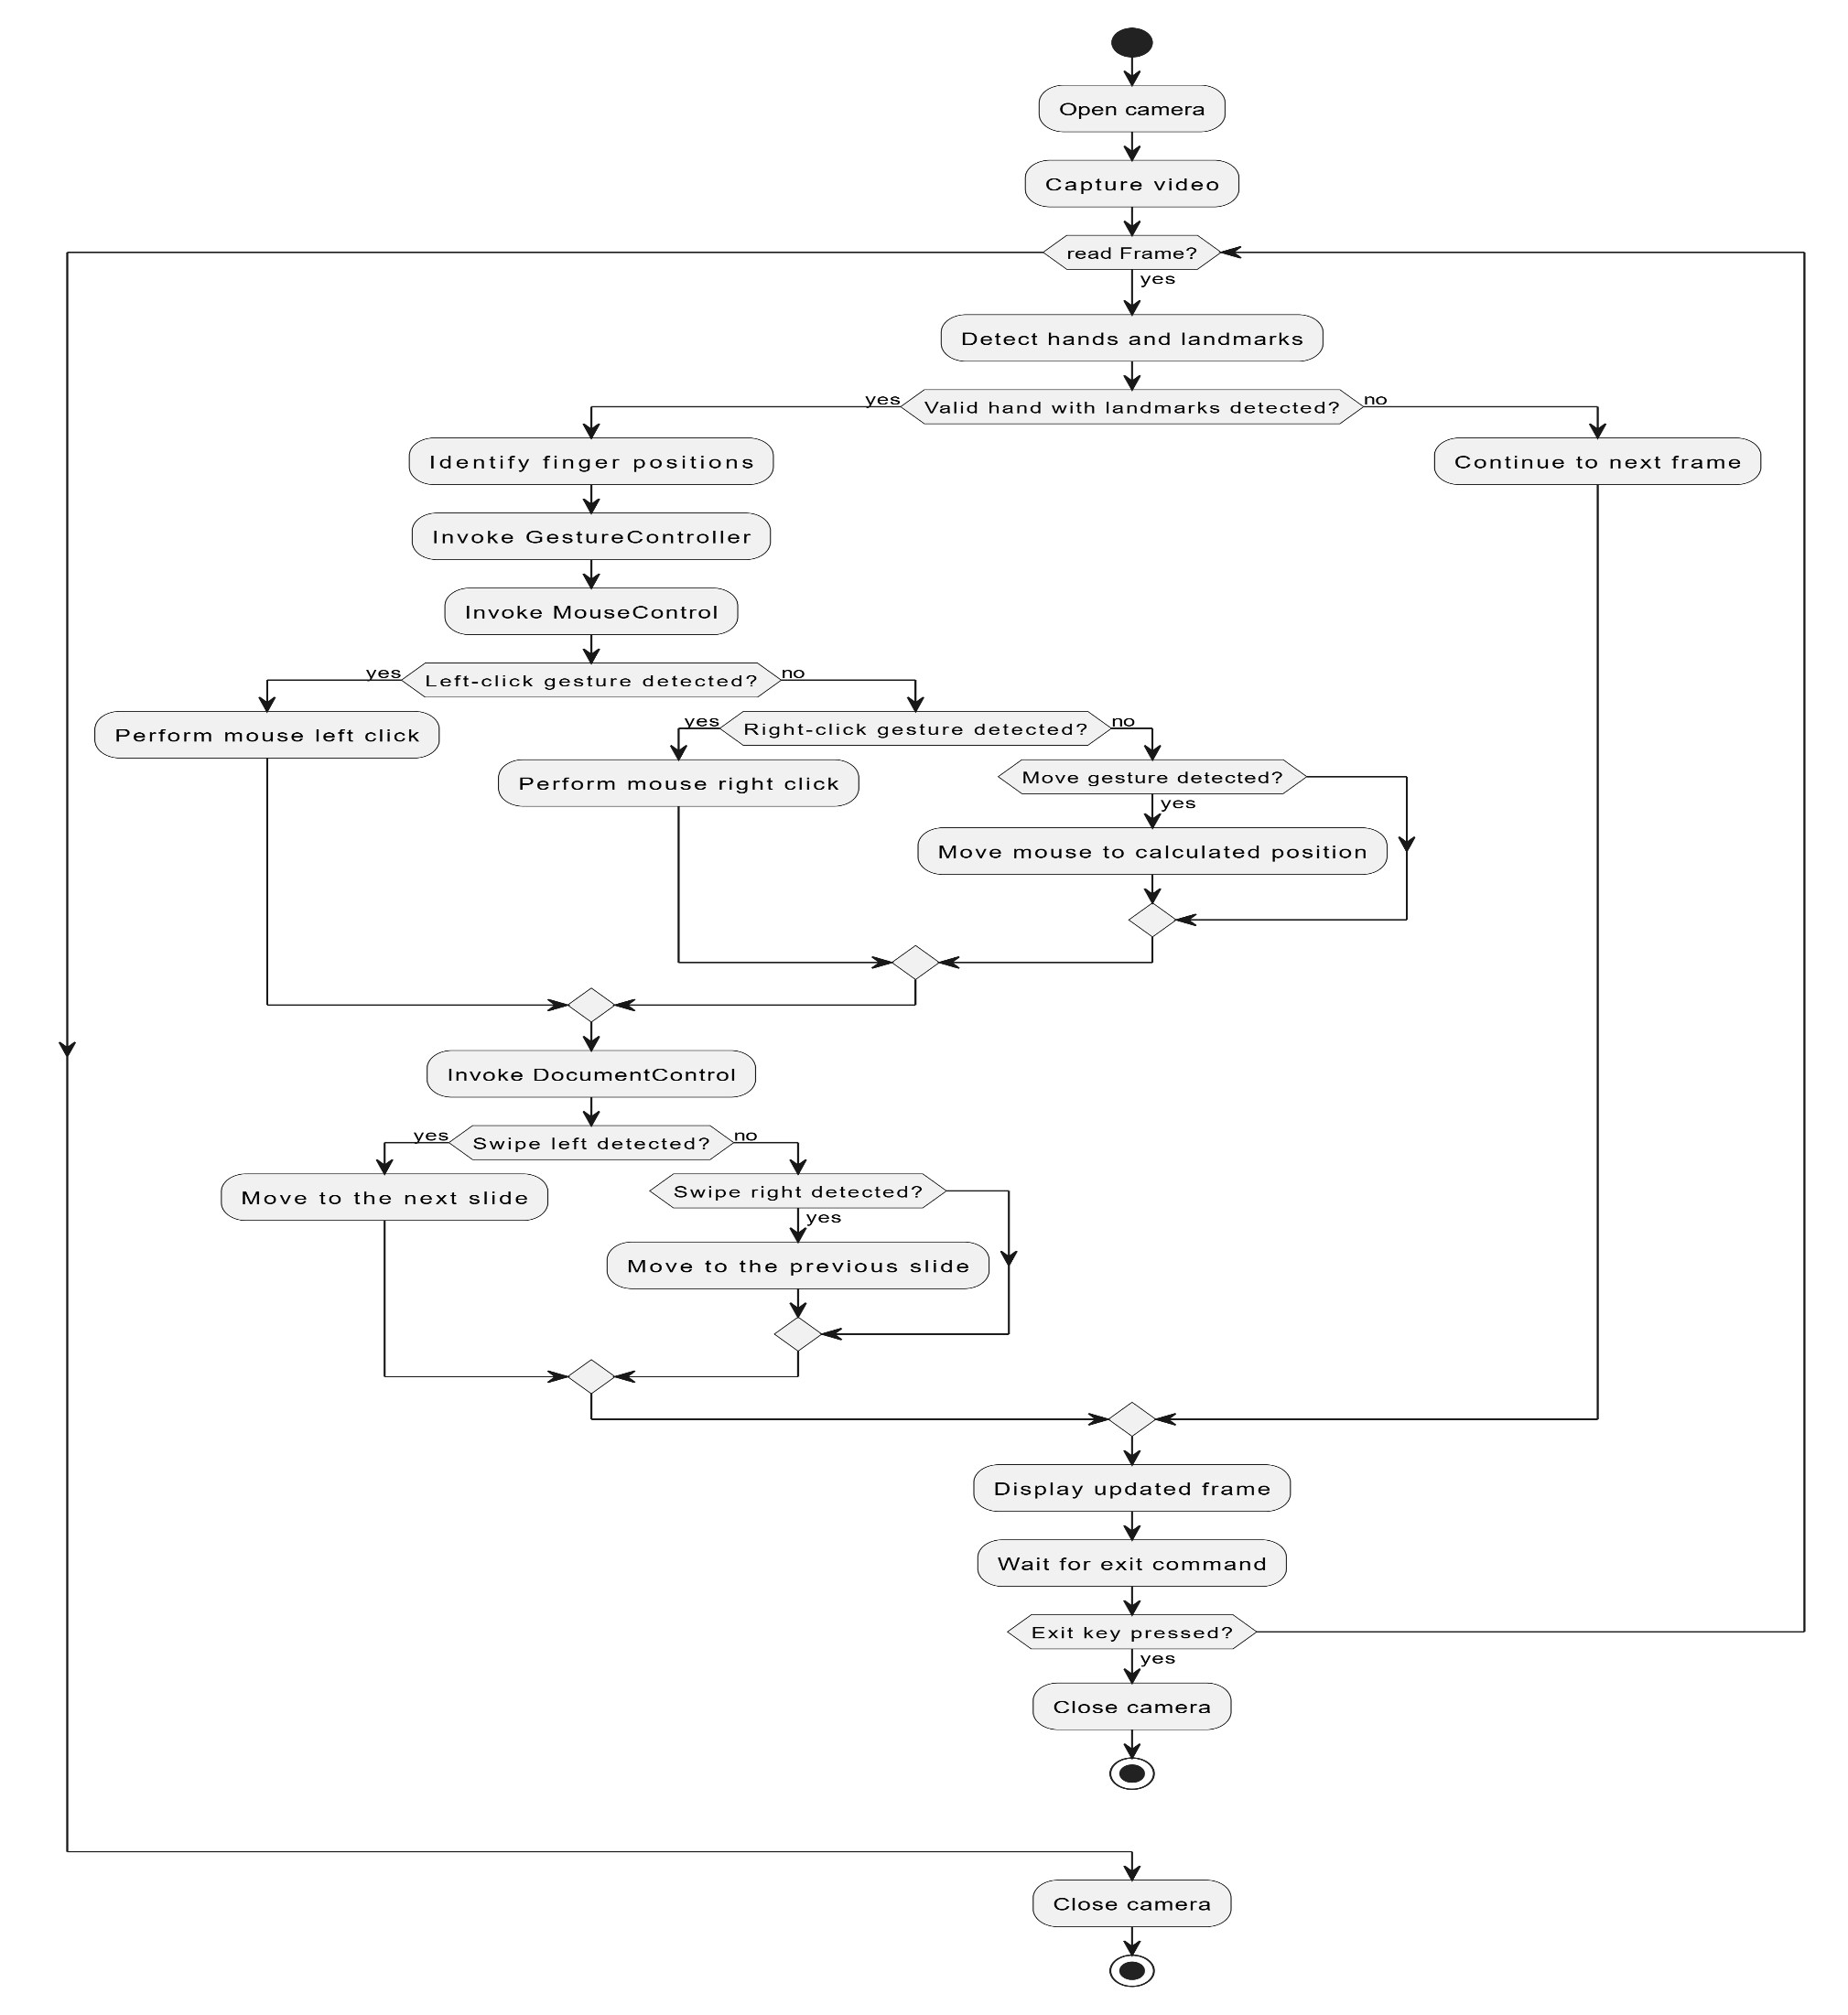
ACTIVITY DIAGRAM

Slide 8
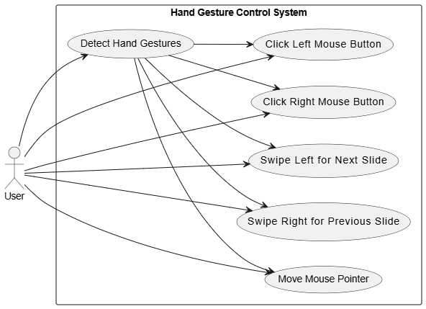
USE CASE DIAGRAM

Slide 9
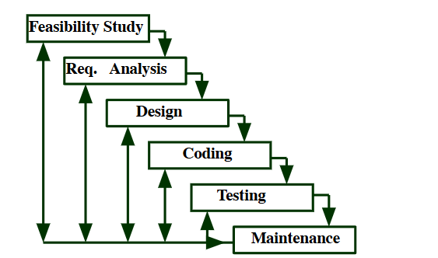
METHODOLOGY
The Methodology for this project follows an iterative Approach:
Beginning with Feasibility Study and then Requirement gathering and analysis to identify the essential gestures for digital interaction.
Next, a modular design is created to ensure each gesture,
the hand detection and gesture recognition modules are developed and tested separately.
Each gesture is mapped to system commands
The approach focuses on accuracy, responsiveness, and usability, ensuring smooth, gesture-based unique digital interaction

Slide 10


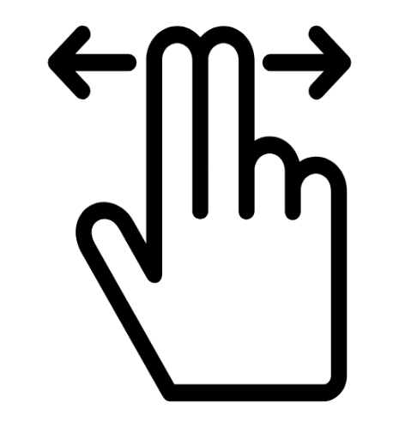


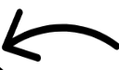
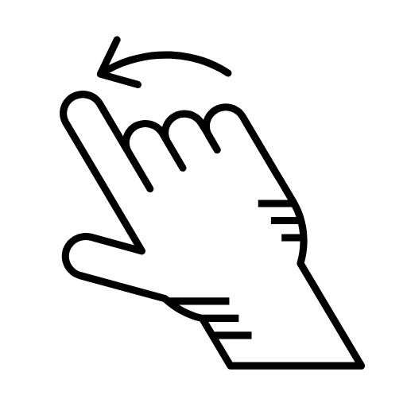


Results
Mouse pointer movement
Goto Previous Slide
Right Click
Goto Next Slide
Left Click

Slide 11
Progress So Far
Implemented:
Hand gesture detection using MediaPipe and OpenCV.
Successfully implemented Document navigation through swipe gestures.
Mouse control using hand gestures (left-click, right-click).
Next Tasks:
Implement Zoom-in and Zoom-out Functionalities
Media Control(Play, Pause, Increase/ Decrease volume)

Slide 12
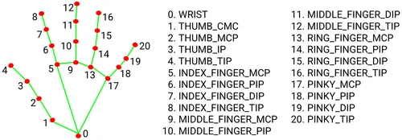

REFERENCES
MediaPipe Documentation:
https://google.github.io/mediapipe
OpenCV Documentation:
https://opencv.org/
pyautogui Documentation:
https://pyautogui.readthedocs.io/en/
Pynput Documentation:
https://pynput.readthedocs.io/
Research Papers and Articles:
Z.Ren, J.Meng, Yuan J. Depth Camera Based Hand Gesture Regconition and its Application in Human-Computer-Interaction. In Processing of the 2011 8th International Conference on Information, Communication and Signal Processing (ICICS).

Slide 13
THANK YOU

